Slide 1
Migrating Oracle to Azure SQL
Notes:
Information in this document, including URL and other Internet Web site references, is subject to change without notice. Unless otherwise noted, the example companies, organizations, products, domain names, e-mail addresses, logos, people, places, and events depicted herein are fictitious, and no association with any real company, organization, product, domain name, e-mail address, logo, person, place or event is intended or should be inferred. Complying with all applicable copyright laws is the responsibility of the user. Without limiting the rights under copyright, no part of this document may be reproduced, stored in or introduced into a retrieval system, or transmitted in any form or by any means (electronic, mechanical, photocopying, recording, or otherwise), or for any purpose, without the express written permission of Microsoft Corporation.
Microsoft may have patents, patent applications, trademarks, copyrights, or other intellectual property rights covering subject matter in this document. Except as expressly provided in any written license agreement from Microsoft, the furnishing of this document does not give you any license to these patents, trademarks, copyrights, or other intellectual property.
The names of manufacturers, products, or URLs are provided for informational purposes only and Microsoft makes no representations and warranties, either expressed, implied, or statutory, regarding these manufacturers or the use of the products with any Microsoft technologies. The inclusion of a manufacturer or product does not imply endorsement of Microsoft of the manufacturer or product. Links may be provided to third party sites. Such sites are not under the control of Microsoft and Microsoft is not responsible for the contents of any linked site or any link contained in a linked site, or any changes or updates to such sites. Microsoft is not responsible for webcasting or any other form of transmission received from any linked site. Microsoft is providing these links to you only as a convenience, and the inclusion of any link does not imply endorsement of Microsoft of the site or the products contained therein.
© 2018 Microsoft Corporation. All rights reserved. Microsoft and the trademarks listed at https://www.microsoft.com/en-us/legal/intellectualproperty/Trademarks/Usage/General.aspx are trademarks of the Microsoft group of companies. All other trademarks are property of their respective owners.

Slide 2
Abstract and learning objectives
Abstract
In this whiteboard design session, you work with a group to design a proof of concept (POC) for conducting a site analysis for a customer to compare cost, performance, and level of effort required to migrate from Oracle to Azure SQL Database. You evaluate the dependent applications and reports that need to be updated and come up with a migration plan. Also, you review ways to help the customer take advantage of new Azure SQL Database features to improve performance and resiliency, as well as explore ways to migrate from an old version of SQL Server to the latest version and consider the impact of migrating from on-premises to the cloud.
At the end of this whiteboard design session, you will be better able to design a database migration plan and implementation.
Notes:
This is an introduction to the Cloud Workshop at a high level. Later we’ll get into customer objections, requirements, etc., but we want to ground the participants on the business outcomes we’re going after for the day.

Slide 3
Step 1: Review the customer case study
Outcome
Analyze your customer needs.
Timeframe
15 minutes

Slide 4
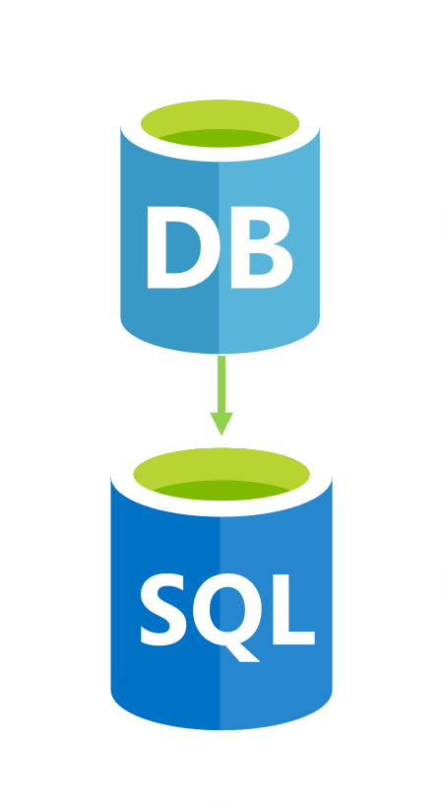
Customer situation
Wide World Importers experience huge growth
Tremendous influx of new data
Outage caused by audit table space shortfall
Requested POC to replace Oracle with Azure SQL Database
Notes:
Wide World Importers (WWI) has had huge growth over the last few years
Resulted in a tremendous influx in new data they need to maintain their business
This data has become increasingly expensive to store in an Oracle Relational Database Management System (RDBMS)
Investigating replacing Oracle with Azure SQL Database
Oracle has been slowing down as their growth has doubled
Oracle upgrades are long and expensive projects
Business stake holders have tired of the process and have requested a proof of concept on replacing Oracle with Azure SQL Database
Investigating ways they can increase speed on their transactional databases without expensive new license fees
Realize an investment in new hardware is required, and are looking at this as more of a migration to a new system
They had a significant outage last year because one of their audit tables ran out of space. They’d like a full briefing on how to monitor that situation, so it doesn’t happen again, possible remedies would like high availability to be built into the project.

Slide 5

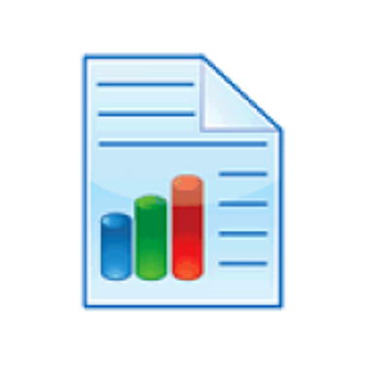

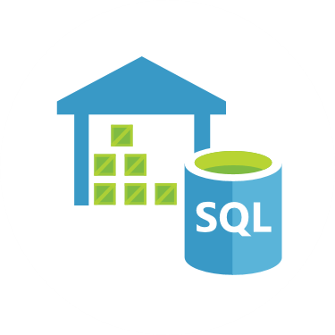
Customer Situation
Apps
Reports
Web/REST
Services
Data
Warehouse
Notes:
WWI has several external and internal applications that need migrate with the database
The database is used by an online store application, written in ASP.NET Core MVC
Also have internal applications that manage their product catalog, written in Oracle Forms
They have many reports to aid in forecasting, sales reporting, and inventory maintenance
Reports are a mixture of SQL Server Reporting Services (SSRS), Excel, and Oracle Forms
Hit the Oracle OLTP database directly
Web / Representational State Transfer (REST) services
WWI also uses this database to interact with vendors, exposing to vendors via a REST service
Maintained by WWI
Existing web service that interacts with a vendor to get the latest certifications of that vendors’ products
The JavaScript Object Notation (JSON) parser sometimes fails and they can’t figure out why
Want to store the original, unparsed JSON in a table for troubleshooting purposes
Want to query the JSON data by date or by other identifying pieces of the JSON that might be available for troubleshooting
WWI also loads data from the Oracle database into a Microsoft SQL Server 2008 R2 Standard Edition data warehouse
Head of IT constantly fails an audit where he is asked if their data warehouse encrypts data at rest
Realizes he needs to upgrade to Azure SQL Database or SQL Server Enterprise Edition and would like to include an upgrade in this POC

Slide 6

Customer needs
Migrate from Oracle to SQL Server (including Azure SQL Database)
Understand SQL Server migration impact on existing apps and services
Upgrade data warehouse to Azure SQL Database or SQL Server 2019 Enterprise Edition
Notes:
Migrate an existing Oracle database to SQL Server 2019 on-premises, SQL Server 2019 in an Azure VM, or Azure SQL Database
Impact on apps and services
Needs to understand what is involved in migrating the external sales application to Azure SQL Database or SQL Server
Wants better understanding of what to do with the internal Oracle Forms application
Has multiple touch points with external vendors and needs to know what needs to change with those web services
Upgrade existing data warehouse from SQL Server 2008 Standard Edition to Azure SQL Database or SQL Server 2019 Enterprise Edition to take advantage of some new features:
They want Transparent Data Encryption, so they pass audit’s when asked if they encrypt data at rest
They want compression for some of their large fact tables
They want to implement SSRS mobile reporting
They hear about in-memory structures and are wondering if they can benefit from those. They aren’t entirely sure how it is different from what they are using now.
They have a lot of SQL Server Integration Services (SSIS) packages that are executed through SQL Server Agent jobs. They’d like to know the upgrade path for those.

Slide 7
Customer needs
Web-based visualizations and reporting
Store raw JSON data
Wants to avoid outages caused by disk space
Does SQL Server have an answer to Oracle RAC
Notes:
Need web-based visualizations on sales and forecasting
Needs a plan on how to upgrade their existing reporting infrastructure
Has a new requirement on what to do with JSON data
Had an outage last year and is hyper concerned with not repeating that experience
Their audit table filled up and they ran out of disk space
Want to know what would have happened if SQL Server experienced the same issue, and what you’re your solution would be
As a follow up, they’d also like to know how to answer the Oracle DBA’s allegation that SQL Server doesn’t have an answer for Oracle Real Application Clusters (RAC)

Slide 8



Customer objections
Does upgrade need to be on-premises first?
Can we see two POCs?
Do apps need to be rewritten?
Do reports need to be rewritten?
Will security migrate over?
Notes:
Do we need to upgrade to on-premises SQL Server first or go straight to Azure?
Can we have two proof of concepts that demonstrate both migrations?
Do we need to rewrite all our applications for SQL Server or Azure SQL Database?
Do we need to rewrite all our reports for SQL Server or Azure SQL Database?
Will our security migrate over from Oracle? How do we handle security in the new database?

Slide 9

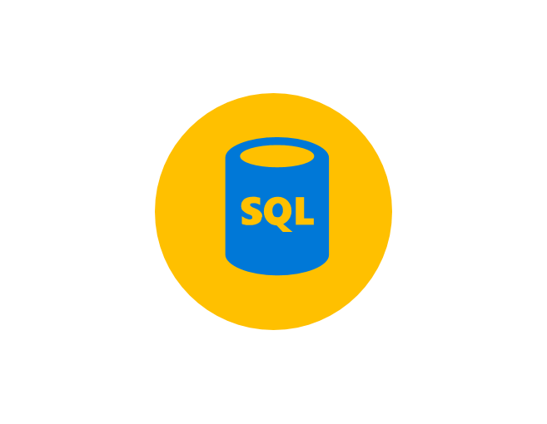
Customer objections
How do we store JSON data?
Will SQL Server crash if audit logs fill up?
How can we control costs using SQL Server?
Are there any features of Oracle that SQL Server does not have?
Notes:
Do we need to invest in a JSON storage system for the JSON data we’re storing from our vendor’s web service?
What will we do if our audit logs fill up again? Will SQL Server crash the same way Oracle did?
If we take advantage of new features, will our license costs keep ratcheting up and up? Will we have a dependable way of budgeting for this project?
Are there any Oracle features required by WWI for which SQL Server has no equivalent?

Slide 10

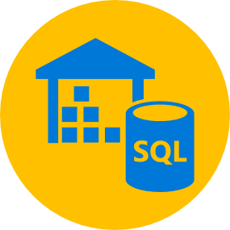
Customer objections
Do we need to inform vendors of database changes?
Is there anything that could prevent upgrading data warehouse?
How will we keep connected dependencies updated to data warehouse?
How will SSIS, SSRS, and SSAS be migrated?
How will SQL Agent Jobs and security be migrated?
Notes:
Do we need to tell all of our vendors that we’re changing databases so their integrations work?
What will stop us from upgrading our data warehouse to Azure SQL Database or SQL Server 2019 Enterprise?
When we upgrade the data warehouse, how will we keep all our connected dependencies updated?
What will happen with SSIS, SSRS, and SQL Server Analysis Services (SSAS)?
How will security and SQL Agent Jobs migrate over?

Slide 11
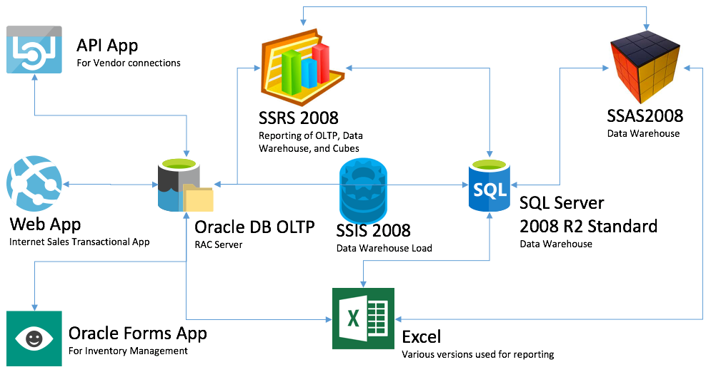
Common scenarios
Notes:
This is a diagram of a common architecture for this type of scenario, from which you can draw inspiration. You will find this diagram within the Whiteboard Design Session Student Guide.

Slide 12
Step 2: Design the solution
Outcome
Design a solution and prepare to present the solution to the target customer audience in a 15-minute chalk-talk format.
Timeframe
60 minutes
Business needs (10 minutes) | Respond to questions outlined in your guide and list the answers on a flipchart.
Design (35 minutes) | Design a solution for as many of the stated requirements as time allows. Show the solution on a flipchart.
Prepare (15 minutes) | Identify any customer needs that are not addressed with the proposed solution. Identify the benefits of your solution. Determine how you will respond to the customer’s objections. Prepare for a 15-minute presentation to the customer.

Slide 13
Step 3: Present the solution
Outcome
Present a solution to the target customer in a 15-minute chalk-talk format.
Timeframe
30 minutes (15 minutes for each team to present and receive feedback)
Directions
Pair with another table.
One table is the Microsoft team and the other table is the customer.
The Microsoft team presents their proposed solution to the customer.
The customer asks one of the objections from the list of objections in the case study.
The Microsoft team responds to the objection.
The customer team gives feedback to the Microsoft team.

Slide 14
Wrap-up
Outcome
Identify the preferred solution for the case study.
Identify solutions designed by other teams.
Timeframe
15 minutes

Slide 15

Preferred target audience
Kathleen Sloan, CIO of Wide World Importers
Primary audience is business and technology decision makers.
Usually talk to Infrastructure Managers who report to the CIO, or to application sponsors (like a VP LOB, CMO) or to those that represent the Business Unit IT or developers that report to application sponsors.
Notes:
Kathleen Sloan, CIO of Wide World Importers (WWI)
The primary audience is business decision makers and technology decision makers
Usually we talk to the Infrastructure Managers who report to the CIO, or to application sponsors (like a VP LOB, CMO) or to those that represent the Business Unit IT or developers that report to application sponsors.

Slide 16
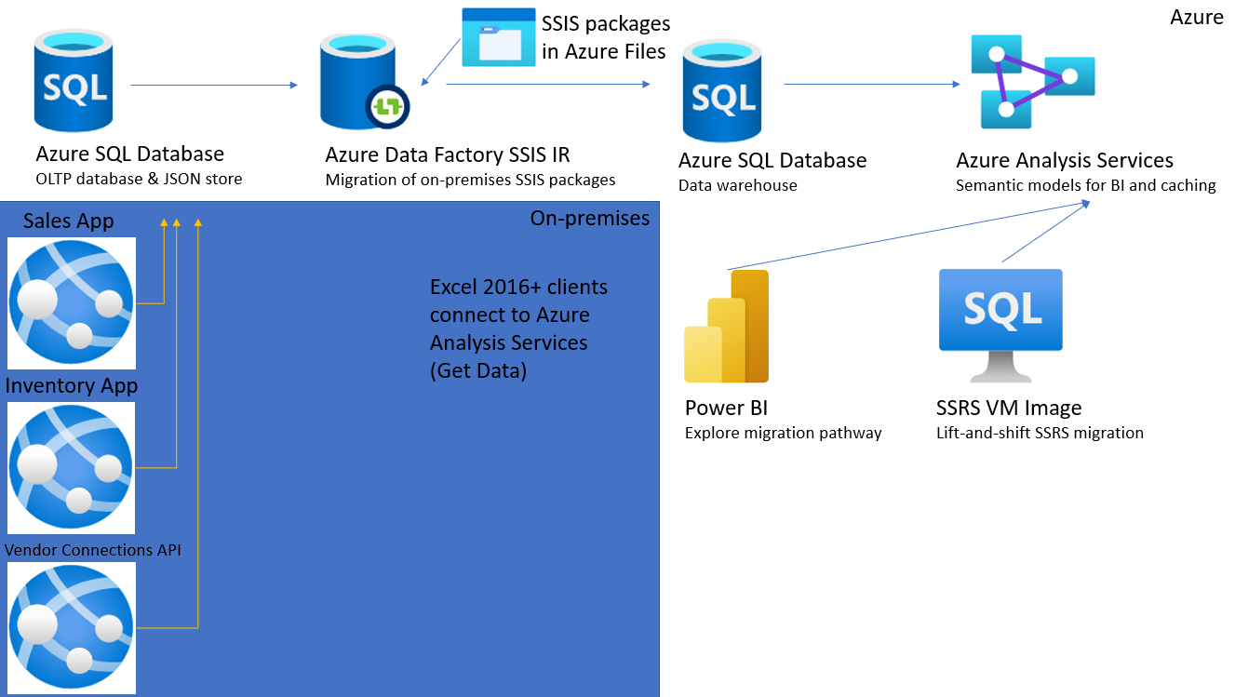
Preferred solution
Notes:
This preferred solution is just one of many viable options
From a high-level:
WWI decided that Azure SQL Database would in fact be the right choice for their platform
Decided to load data and schema using the SQL Server Migration Assistant
Migrate their Oracle Forms application to Microsoft ASP.NET Core
They are very concerned about how to do this and what method to use
They are leaning towards a total rewrite to ASP.NET Core. They would like the POC to include this.
The POC should demonstrate that Azure SQL Database will give them the reliability and performance they expected Oracle to deliver for them
They would like to migrate their data warehouse to Azure SQL Database
POC should include:
MVC app which changes the connectionString from Oracle to Azure SQL Database in Entity Framework Core (EF Core)
A basic form which mirrors the Oracle Forms app
Current Oracle database migrated to Azure SQL Database in a test environment
Include SSIS, SSAS, and SSRS
Test reporting on some Excel worksheets
JSON data store
Failover groups
An upgraded data warehouse, using Azure Database Migration Service
Include Table Compression, Transparent Data Encryption, and Clustered ColumnStore indexing

Slide 17
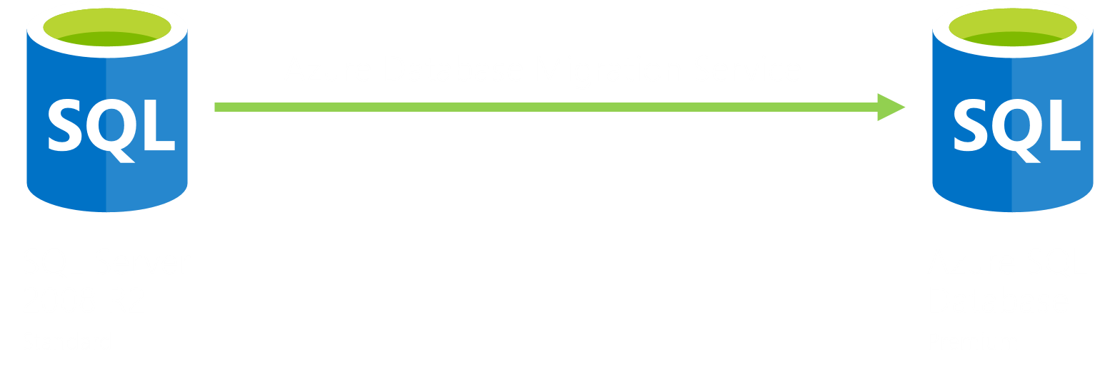
Preferred solution
Data warehouse schema and data movement
(Cloud migration)
Notes:
How would you recommend that WWI move their data warehouse (SQL Server 2008 R2) data and schema into Azure SQL Database? What services would you suggest and what are the specific steps they would need to take to prepare the data, to transfer the data, and where would the loaded data land?
Azure Database Migration Service (DMS) was created and supported by Microsoft to help customers migration their on-premises SQL databases into the cloud, targeting either Azure SQL Database or Managed Instance.
To migrate using DMS:
Create target database
Perform an assessment with Data Migration Assistant (DMA) on the source database to identity any potential issues that need to be address prior to a cloud migration
Create a new migration project
Migrate the schema using DMA
Migrate the data using DMS
Perform a manual switchover of your production environment to the new cloud database

Slide 18
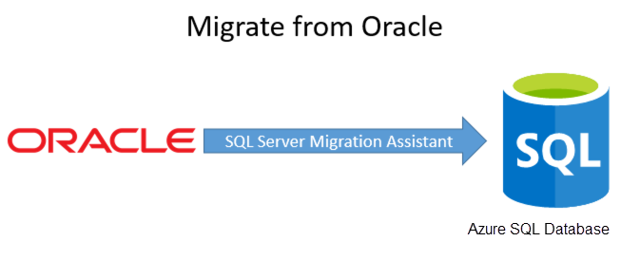
Preferred solution
Oracle schema and data movement
Notes:
How would you recommend that WWI move their data and schema into Azure SQL Database? What services would you suggest and what are the specific steps they would need to take to prepare the data, to transfer the data, and where would the loaded data land?
SQL Server Migration Assistant (SSMA) was specifically created and supported by Microsoft to help Oracle customers move their schema and data over to Microsoft SQL Server or Azure SQL Database
First you create a new project. Then you connect to the Oracle source database. Then connect to the Azure SQL Database or SQL Server destination database. Map Oracle schemas to the target database. Prior to synchronizing the objects into the SQL Server database, the SSMA for Oracle assemblies must be marked as trusted assemblies, so the synchronization can complete successfully. This step is unnecessary for Azure SQL Database migrations. Once that is completed, synchronize all the objects. Lastly, you can move all the data into SQL Server or Azure SQL Database.
You can also use SSMA to create scripts that you can modify by hand, if you’re more comfortable looking at the objects one at a time
You can also use SSMA to only migrate the schema and then use another tool to load the data, like SSIS. This might be a better option if you are planning to run both databases in tandem with each other.

Slide 19
Preferred solution
Application changes
Are they using an ORM for apps and services
Oracle Forms app needs to be rewritten
Store, manage, and query JSON with Azure SQL Database or SQL Server 2019
Notes:
What product would you recommend WWI to migrate their store front MVC application to the new SQL Server database?
A specific product might not be needed, but you might evaluate whether they are using an ORM or not. If they are using Entity Framework (Core), Dapper, or nHibernate, then the application should migrate much more easily.
If they didn’t use an ORM, then much of the data-layer code will need to be rewritten
If this code is consolidated, and only plain old CLR objects (POCOs) are being handed back using the repository pattern, then we might be able to replace the entire tier with Entity Framework or another object-relational mapping (ORM) tool
If there has been bleeding between the layers, then this process might be significantly more difficult
The entire store front application would need to be refactored and tested eventually
For the POC, they are looking to switch the connection string, test several pages related to an order, and get a good idea on the work that would be necessary to get that to work.
Use the Microsoft Data Access Migration Toolkit when migrating Java applications from Oracle to SQL Server. VS Code extension
How would you migrate the Oracle Forms applications? How would you define success? Are there any technologies the customer needs to know about?
The Oracle Forms application will need to be completely rewritten
There is guidance from Microsoft on how to do that to Visual Basic.NET
There are third party tools that will attempt to automatically rebuild an Oracle Forms application to Windows Presentation Foundation (WPF) and Model-View-ViewModel (MVVM)
You can also rewrite this by hand into any technology the client would like
Oracle Forms applications cannot be easily cloud hosted. This application would eventually need to be rewritten if they’d like new experiences like a mobile experience, a tablet application, or hosted in Microsoft Azure.
What will you do about the vendor touch points? How will you recommend they store the JSON data? The REST services need to be approached the same way the MVC store front application is approached. If they’ve used an ORM, then we can just repoint the connectionStrings and redeployed.
JSON data can be stored in a nvarchar field in Azure SQL Database or SQL Server 2019
Managed through the JSON functions of T-SQL
They can be queried and indexed through the JSON features
The REST services need to be approached the same way the MVC store front application is approached. If they’ve used an ORM, then it is likely we can repoint the connectionStrings and redeploy.

Slide 20
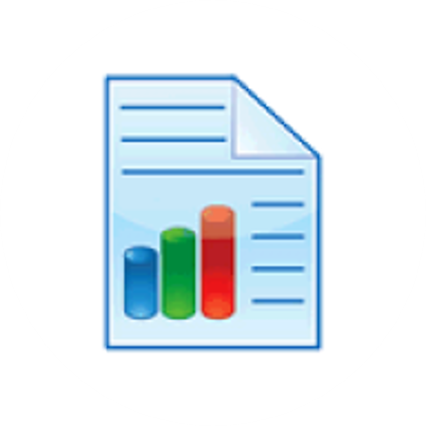
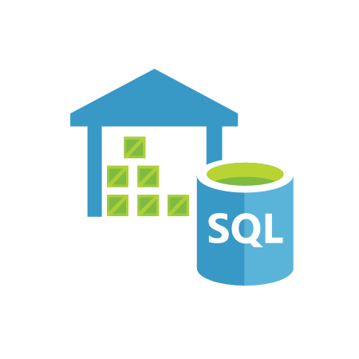

Preferred solution
Data warehouse and reporting
Reports
Identify
Upgrade
Data Warehouse
Assess
Plan
Migrate
Data Migration Assistant
Assessment
Migration
Report
Notes:
How can they discover what reports and Excel spreadsheets that hit the Oracle database need to be upgraded? What’s a proper upgrade path?
There’s an Oracle Profiler API that can be used to store trace information into tables. These tables can be queried to see if we’ve identified all reports and artifacts that we need to upgrade.
We can put individual queries into stored procedures and upgrade them using SSMA. We can also use SSMA to upgrade individual queries to T-SQL
What must change about the way WWI loads their data warehouse?
We need to identify all the SSIS extract, transform, and load (ETL) packages that load data from Oracle to SQL Server 2008 R2. Those SSIS packages will then be executed using the Azure-SSIS integration runtime in Azure Data Factory. Tools to support this deployment include SQL Server Data Tools (SSDT) and SQL Server Management Studio (SSMS).
If the stakeholder does not want to migrate to a PaaS platform, it is possible to run SSIS packages on an Azure SQL VM. However, even this approach offers cost benefits for existing licenses, flexible hardware configuration (scalability), and automated backups and patching.
What components do we need to use to upgrade the SQL Server 2008 R2 data warehouse to Azure SQL Database or SQL Server 2019 Enterprise?
We will have to account for SQL Server security, SQL Server agent jobs, and external applications that might be hitting the engine and SSAS
SSRS, SSAS, and SSIS must be deployed to Azure VMs or the PaaS equivalents of these products. Depending on the migration time frame and complexity of the on-premises solution, WWI can determine the appropriate option.
Identify the major milestones of delivering an upgrade to Azure SQL Database or SQL Server 2019 Enterprise.
A proper upgrade plan might look something like this:
Assess
Identify and Understand required changes
Understand how to leverage new features
Plan
When can I perform the migration?
How will I apply required fixes?
Migrate
Perform schema and data movement
Execute post migration fixes
Are there any tools or processes that would make this easier?
Azure Database Migration Service
Microsoft’s Data Migration Assistant
Can be used to upgrade the SQL Server Data Warehouse
Can upgrade the data and schema in the database, as well as the SSIS database (if there is one), SQL Logins, SQL Agent Jobs, and SSIS packages
When doing the assessment, WWI can choose which Compatibility Level they want to target
Don’t need to jump all the way forward to the very latest level right away
Can help reduce the number of blocking issues they need to address manually before starting the migration
What are the post upgrade steps we should consider in the POC? How would this address their concerns?
The Data Migration Assistant, used in homogenous SQL Server to Azure SQL Database migrations, generates a report which is exported to a CSV file. It should be reviewed for post-migration tasks identified by the Data Migration Assistant
After the upgrade, they need to quickly implement Transparent Data Encryption. This might complicate their populating test servers because a certificate and password are necessary to move the database to a new server.
They can immediately implement table compression in test. Compression might put a load on their processor, but they should notice a big performance increase related to disk I/O. Compressing the large fact tables and large dimension tables should improve performance.
Once installed, they can begin to experiment with SSRS mobile reporting and Power BI
They should test if they get a performance increase by creating clustered ColumnStore indexes. Particularly, they should test their ETL processes.
The customer cited concerns with a slow data warehouse. Implementing compression and ColumnStore clustered indexes will likely alleviate the performance issues. Transparent Data Encryption will help them pass their audits.
Also, consider using the Database Experimentation Assistant to prove that these changes have improved query performance of the SQL Server Data warehouse.

Slide 21
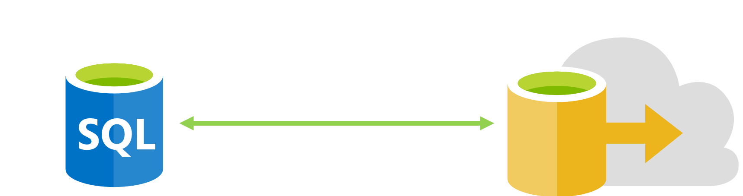
Preferred solution
High-availability and audit table
On-premises
SQL Server 2019 Enterprise Edition
Azure SQL Stretch Database
Notes:
If our solution was SQL Server, what could WWI have done with the audit table when it filled up?
Implement SQL Server Stretch Database to grow the audit table while we worked on a long-term solution
There are other possible answers below:
Use views to extend the table to another drive. Create a view with the original table name. Have two tables behind it, one on each different drive. Use instead of triggers to intercept the inserts and in the trigger, choose the active table.
Use table partitions and move a newer partition to a new drive
Archive older records temporarily while we implement a longer-term solution
With Azure SQL Database, as it is a PaaS offering, scaling compute and storage with minimal downtime is simple. However, it is not automatic. Microsoft provides scripts to automate this process
What are the SQL Server options for high availability?
SQL Server provides several options for creating high availability for a server or database. High-availability options include the following:
Failover clustering
Database mirroring
Log shipping
Replication
Scalable shared databases
With Azure SQL Database, it is easy to incorporate failover groups into your solution. Failover groups implement geo-replication and promote secondary servers in the case of regional outage

Slide 22

Preferred solution
Azure SQL Database POC
On-premises upgrade acceptable option
Consider migration into Azure for long-term cost savings and simplifying future upgrades
Answer questions before beginning POC
Notes:
Should they move to on-premises first?
This is a perfectly acceptable option
If we do, we might consider using AlwaysOn, and creating a copy of the data in Azure as an AlwaysOn Secondary
This would keep an active, current copy of the data in the cloud that we could use for Power BI, other Azure-based applications, or as part of a future Azure migration
Other on-premises applications might keep them on-premises until they can figure out how to move those applications to the cloud
It depends on the integration touchpoints, network latency needs, and reliable internet connectivity for all offices
Is there any benefit to going straight to Microsoft Azure? Does Azure SQL Database take care of all of their requirements?
If the organization has chosen to go to the cloud, this might be a long-term cost savings of skipping purchasing the on-premises hardware
If the applications are already cloud born, or they have many external applications needing access, then this would not affect latency while removing the burden from WWI of maintaining the connectivity with all their integration partners
In addition, they would gain the benefit of simplifying future software upgrades. Some of their products would upgrade and offer new features with minimal effort on their part.
Are there any questions we need answered before we can begin a POC directly to Microsoft Azure?
What is network connectivity like between on-premises and the cloud?
What are our long-term cloud plans? Is there a mandate to go there any way?
Where is the rest of the data integration points stored? Are they on-premises? Is anything in Microsoft Azure already?
Are there any cloud products that are already on the roadmap for the organization?

Slide 23
Preferred objections handling
Does upgrade need to be on-premises first?
Can we see two POCs?
Do apps need to be rewritten?
Do reports need to be rewritten?
Will security migrate over?
Notes:
Do we need to upgrade to on-premises SQL Server first or go straight to Azure?
This is joint business decision and technical decision. Azure SQL Database or Azure SQL in a VM will offer all the features they’ve stated that they need. There’s a migration path to both.
If they have a long-term strategy to move to the cloud, have already moved some resources there, have a plan to co-locate with a partner data center, or have identified cloud services they’d like to take advantage of, then moving straight to the cloud might be preferred
It might be easier to be on-premises if they don’t have Express Route for their Excel spreadsheets and other on-premises resources that can’t migrate to Azure quite yet.
Can we have two proof of concepts that demonstrate both migrations?
Two proof of concepts are possible and easy to do.
The application architecture might be quite a bit different if we choose to use Platform as a Service (PaaS)
The online sales application and the web services would migrate to Azure App Service
SSRS would migrate to a VM running the SSRS Marketplace VM image or Power BI
The RDL migration tool may help migrate some SSRS reports to Power BI
The data warehouse can move to the cloud to take advantage of its scalability, security, and performance features
If it stays on-premises, then data movement from the new Azure SQL OLTP database to the on-premises SQL Server 2019 Enterprise data warehouse would need to be addressed. Again, ExpressRoute might be needed.
Do we need to rewrite all of our applications for SQL Server?
The Oracle Forms application would have to be rewritten to ASP.NET Core or ASP.NET MVC
Migration tools available to help from third-parties if they choose to migrate to ASP.NET MVC
The rewrite effort will need to be planned and implemented.
For the POC, show a basic CRUD (create, read, update, delete) data entry form to show how the project would be structured
Use Entity Framework if appropriate to make the CRUD migration easier
Use of Entity Framework Core, or another ORM, in the existing applications and services will make migration easier
It’s possible that we could repoint the connectionString, re-run the unit tests, and the application will just work
Blockers might be if Entity Framework Core is using Stored Procedures in Oracle. Those will need to be tested after we run the SQL Server Migration Assistant.
For Java applications, Microsoft provides the Data Access Migration Toolkit VS Code extension
Do we need to rewrite all of our reports for Azure SQL Database?
Microsoft provides SQL Server 2019 Reporting Services and SQL Server 2016 Reporting Services VM images
If Excel reports use simple queries to views or stored procedures, then changing the connectionString might work with them, also. If not, then the queries that drive the spreadsheets will need to be rewritten
The SQL Server Migration Tool can also convert specific, individual queries from PL/SQL to T-SQL
Will our security migrate over from Oracle to SQL Server? How do we handle security in the new database?
Security roles, users, and permissions will need to be recreated. Schema can be mapped and migrated over to the new server.

Slide 24
Preferred objections handling
How do we store JSON data?
Will SQL Server crash if audit logs fill up?
How can we control costs?
Are there any features of Oracle that SQL Server does not have?
Notes:
Do we need to invest in a JSON storage system for the JSON data we’re storing from our vendor’s web service?
JSON data can be stored in SQL Server as a nvarchar field
It can be queried and indexed using JSON keywords in T-SQL.
It can be queried and flattened to be used in an SSRS report of bad data that didn’t parse when we processed it with the web service (a customer concern they mentioned having previously)
What will we do if our audit logs fill up again? Will SQL Server crash the same way Oracle did?
We can use SQL Server Stretch Database to extend the audit table to Azure
We can also partition big tables and put the new partition on a different drive that doesn’t have space problems
Since Azure SQL Database is used in this solution, it can scale quickly and be monitored through Log Analytics Workspaces
If we take advantage of new features, will our license costs keep ratcheting up and up? Will we have a dependable way of budgeting for this project?
Microsoft offers license assistance programs for current Oracle users migrating to on-premises SQL server
This program can offer free licenses to current Oracle customers
They can also subsidize the cost of the migration process
SQL Server licensing also includes all available features in the Enterprise Edition with no additional cost for each feature implemented
Multiple cost-saving measures available for Azure SQL Database users
Hybrid benefit (for on-premises SQL Server to Azure SQL Database migrations)
Reserved capacity
DTU and vCore pricing models to simplify cost management and tier/server specification
Are there any Oracle features required by WWI for which SQL Server has no equivalent?
Nothing in the customer requirements is exclusive to an Oracle ecosystem
Oracle Forms is unique to Oracle, but Microsoft offers several replacement technologies, including LightSwitch, SharePoint Forms, Power Apps, ASP.NET MVC, WPF Forms, and ASP.NET Core applications
The customer might implement Oracle RAC, but AlwaysOn Availability Groups for on-premises and hybrid deployments are easier to implement, cheaper, and have lower hardware requirements

Slide 25
Preferred objections handling
Do we need to inform vendors of database changes?
Is there anything that could prevent upgrading data warehouse?
How will we keep connected dependencies updated to data warehouse?
How will SSIS, SSRS, and SSAS be migrated?
How will Agent Jobs and security be migrated?
Notes:
Do we need to tell all of our vendors that we’re changing databases so their integrations work?
As long as we test and refactor the web services they use, they shouldn’t know that you switched your back-end data store
What will stop us from upgrading our data warehouse to Azure SQL Database or SQL Server 2019 Enterprise?
Thought needs to be given to upgrading the database storage engine, SQL Server Analysis Services, SQL Server Reporting Services, and SQL Server Integration Services. SSRS and SSIS have been completely redone since SQL Server 2008, with new interfaces and new engines. SSAS multidimensional also has a new engine with the tabular engine. Thought needs to be given if it will be implemented.
Azure supports hosting WWI’s BI stack in the cloud
SSRS on a VM (IaaS) and Power BI (PaaS)
SSAS on a VM (IaaS) and Azure Analysis Services (PaaS)
There are limitations to these technologies (e.g., Azure Analysis Services does not support multidimensional cubes)
When we upgrade the data warehouse, how will we keep all our connected dependencies updated?
If we don’t change the server name, our job is much easier. We might not even need to modify the connectionStrings. We can keep the server name the same by either doing an in-place upgrade or by migrating to a new server and then changing the name of the new server to a new name. If we migrate to a new server, we will need to migrate security logins and permissions, along with the database
SQL Server Agent jobs are only supported with Azure SQL Managed Instance
What will happen with SSIS, SSRS, and SSAS?
SSIS:
Local
Natively in Azure SQL Managed Instance (through Agent jobs)
Azure Data Factory through the SSIS Integration runtime
SSRS:
Power BI migration path
SSRS in an Azure VM
SSAS:
Azure Analysis Services
SSAS in an Azure VM
Keeping SSIS, SSRS, SSAS on-premises: Once the server is upgraded, we should redeploy the SSIS, SSAS, and SSRS projects after changing the connectionStrings. If we used project connectionStrings, this will be much easier. All external connections should be tested thoroughly.
If we use Database Migration Assistant, SSIS packages will upgrade during the process and will migrate over to the new server.
How will security and SQL Agent Jobs migrate over?
If we use Database Migration Assistant, security and the SQL Server Agent Jobs will migrate over to the new server
Agent jobs are supported in Azure SQL Managed Instance

Slide 26
Customer quote
“We are excited that a SQL Server environment will help our organization grow and prosper for many years into the future.”
- Kathleen Sloan, CIO of Wide World Importers

